Slide 1
Pre-course Assignment
1 Minute Intros – Please complete two slides using the following template.
Slide 1 - Include a brief slide with your photo and interesting info you'd like to share about yourself, including your current position and location.
Slide 2 – Insert a photo from a grazing system and describe why you think that represents a Soil Health Grazing System.
When completed: Add your Last Name to the end of the filename. Save it to the following link:
https://usdagcc.sharepoint.com/:f:/r/sites/FPAC-NRCS-SHD-SoilHealthPOCs/Shared%20Documents/General/Advanced%20Soil%20Health%20in%20Pasture%20and%20Silvo-pasture%20Adaptive%20Management%20Training%20Course/Pre-course%20Assignments?csf=1&web=1&e=hkNqVK
Thank you!

Slide 2
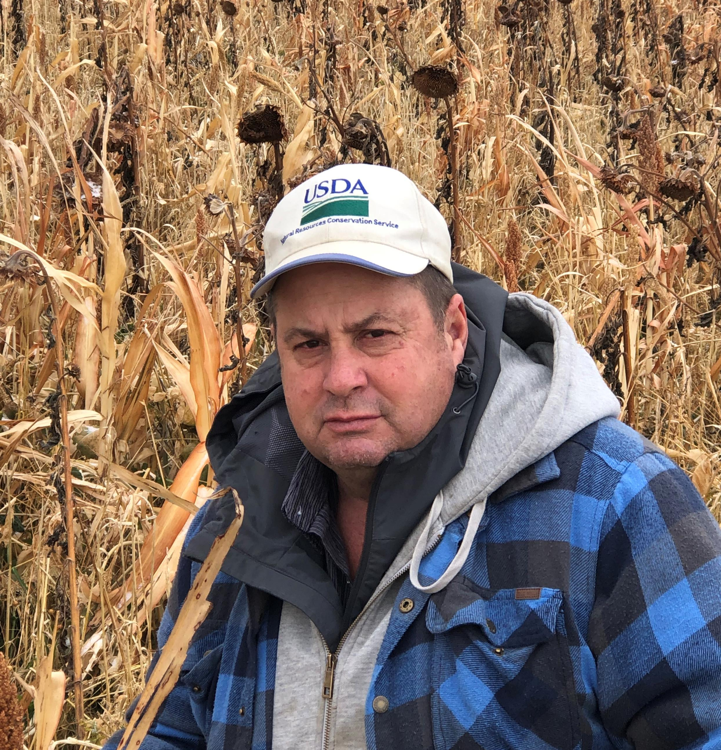
Marlon Winger
Soil Health Division Specialist, CO, UT, WY
Example Slide
Grew up on family dairy farm in Dayton, Idaho
BS and MS in Plant Science from Utah State University
County Agricultural Agent, USU at Price, Utah
NRCS, Area Agronomist, State Agronomist, SHD
Lived on a farm, or ranchette my whole life.
  cattle, sheep, hogs
  alfalfa, corn, wheat, barley, oats,
  peas, beans, sugar beets, potatoes, pasture

Slide 3
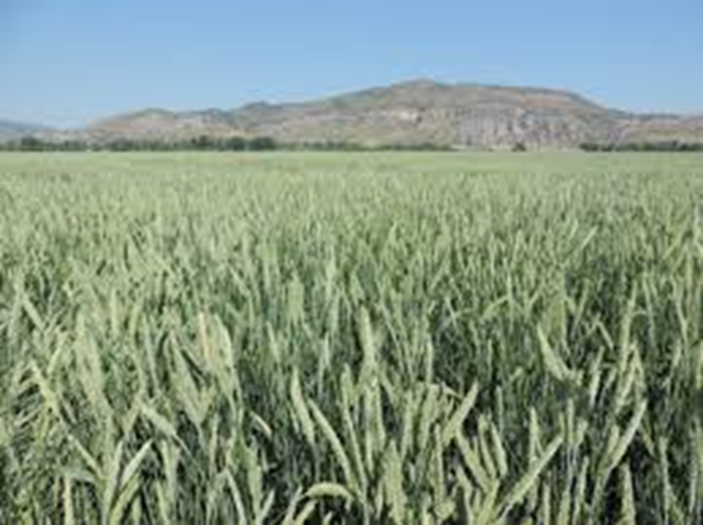
Insert photo here and explain or short story

Slide 4
Thank you!
For more information on Managing Soil Health,
visit us here:
https://www.nrcs.usda.gov/conservation-basics/natural-resource-concerns/soils/soil-health
USDA is an equal opportunity provider, employer, and lender.

